Slide 1
CSS FOUNDATION FRAMEWORK.
Title: "Building a CSS Foundation Framework"
Subtitle: "A Modular and Scalable CSS Framework for Modern Web Development"
Your Name: [ABDUL RAHEMAN]
Date: [17/11/2024]

Slide 2
What is Foundation?
Definition: Foundation is a responsive front-end CSS framework for building modern web interfaces.
Developed By: Zurb.
Purpose: To provide a scalable, modular, and flexible foundation for web design.
Key Features:
Mobile-first
Prebuilt components
Customizable

Slide 3
Introduction to Foundation
What is Foundation CSS?
Purpose: A responsive front-end framework for building websites.
Simple, mobile-first approach with pre-styled components.

Slide 4
Installation and Setup
Fast setup options using CDN.
Installing with npm / yarn for development.
How to add Foundation CSS to your HTML page.
Example Code:
html
<!-- Link to Foundation via CDN -->
<link rel="stylesheet" href="https://cdn.jsdelivr.net/npm/foundation-sites/dist/css/foundation.min.css">

Slide 5
Buttons in Foundation
Content:
Simple button styles using classes like button, primary, alert.
Foundation provides different button styles for quick use.
Example Code:
html
<button class="button primary">Primary Button</button>
<button class="button secondary">Secondary Button</button>
<button class="button alert">Alert Button</button>
Visual Example: Screenshot of the different button styles.

Slide 6
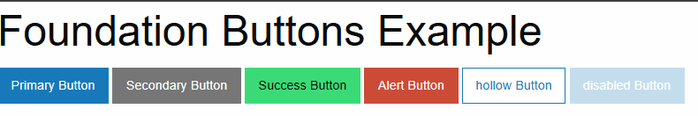

Slide 7
Navigation Bar Example
Content:
How to create a basic navigation bar using Foundation's menu class.
Navigation is responsive by default.
Example Code:
html
<ul class="menu">
<li><a href="#">Home</a></li>
<li><a href="#">About</a></li>
<li><a href="#">Services</a></li>
<li><a href="#">Contact</a></li>
</ul>

Slide 8

Navigationbar output example :

Slide 9
Forms in Foundation
Content:
Basic form styling with Foundation's input and form elements.
Example of a simple form with inputs and a submit button.
Example Code:
html
<form>
<label>Name
<input type="text" placeholder="Your Name">
</label>
<label>Email
<input type="email" placeholder="example@domain.com">
</label>
<button type="submit" class="button primary">Submit</button>
</form>

Slide 10
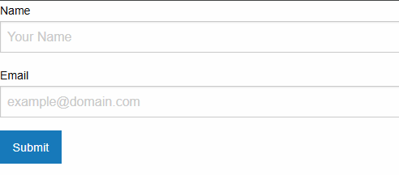
Forms In foundation output example :

Slide 11
Creating a Card with Foundation
Content:
How to create a card using Foundation's panel component.
Panels are useful for grouping content with borders or background.
Example Code:
html
<div class="callout">
<h5>Card Title</h5>
<p>This is a simple card example using a Foundation callout.</p>
<a href="#" class="button small">Read More</a>
</div>.

Slide 12
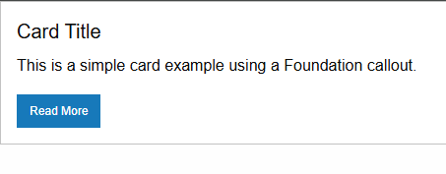
Card foundation output example :

Slide 13
Foundation's Responsive Images
Content:
How to make images responsive with Foundation's .thumbnail class.
Demonstrates automatic scaling for different devices.
Example Code:
html
<img src="example.jpg" class="thumbnail" alt="Responsive Image Example">
Visual Example: An image adjusting its size on different screen widths.

Slide 14
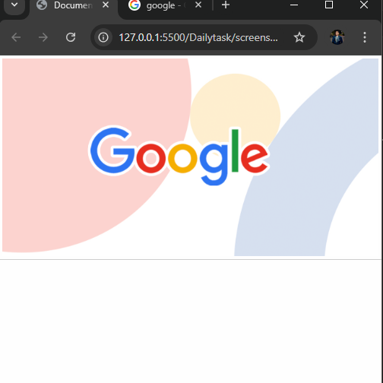
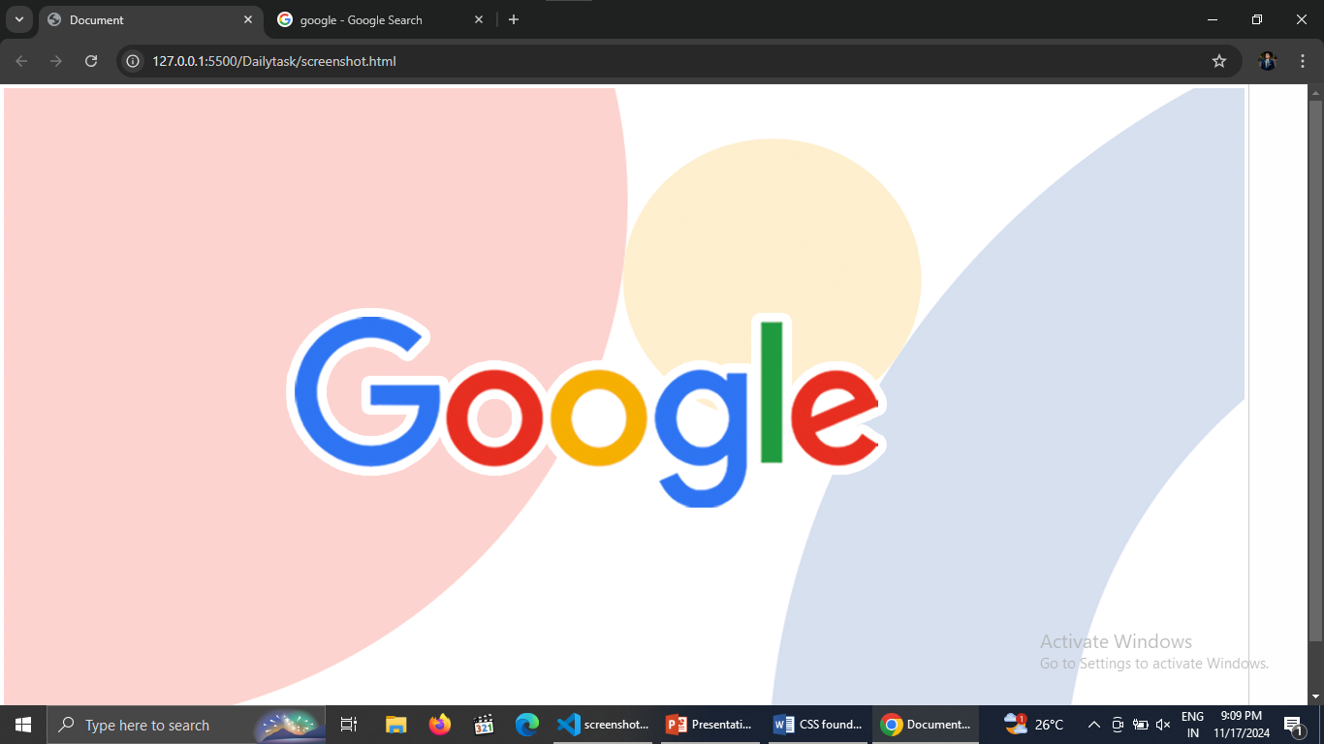
Responsive image foundation output example :

Slide 15
Foundation Grid System
Overview of the grid system using rows (grid-x) and columns
(cell).
The foundation grid is based on a 12-column layout.
Example Code:
html
<div class="grid-container">
<div class="grid-x grid-padding-x">
<div class="cell small-6">50% Width (Small)</div>
<div class="cell small-6">50% Width (Small)</div>
</div>
</div>
Visual Example: Diagram with two side-by-side boxes, each occupying 50% width.

Slide 16
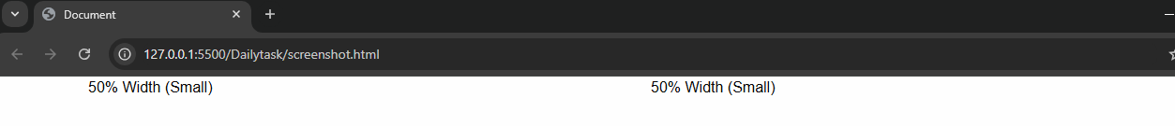
Foundationgrid output example :

Slide 17
Modal Example in Foundation
Content:
How to create a simple modal using Foundation's reveal class.
Modals can be triggered with buttons or links.
Example Code:
html
<!-- Trigger Button -->
<button class="button" data-open="exampleModal">Open Modal</button>
<!-- Modal Content -->
<div class="reveal" id="exampleModal" data-reveal>
<h1>Simple Modal Example</h1>
<p>This is a modal window with some sample content.</p>
<button class="close-button" data-close>&times;</button>
</div>

Slide 18
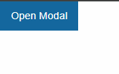
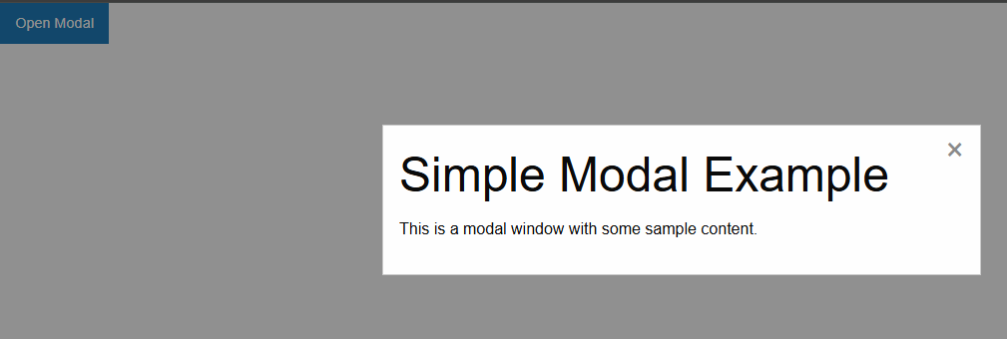
Modal output example :

Slide 19
Foundation Typography
Content:
Examples of Foundation's pre-defined typography classes.
Showcasing headings, paragraphs, and text styles.
Example Code:
html
<h1>This is a Heading 1</h1>
<p class="lead">This is a lead paragraph with emphasized style.</p>
<p>This is a standard paragraph.</p>
Visual Example: A screenshot of various text styles with different fonts.

Slide 20
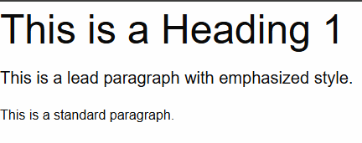
Typography foundation output example :

Slide 21
Responsive Footer Example
Content:
Example of a simple responsive footer with multiple columns.
Use Foundation’s grid system to layout the footer.
Example Code:
html
<footer class="grid-x grid-padding-x">
<div class="cell small-6 medium-4">© 2024 My Website</div>
<div class="cell small-6 medium-4">Links</div>
<div class="cell small-12 medium-4">Contact Info</div>
</footer>
Visual Example: A simple, multi-column footer layout.

Slide 22
Responsivefooter example output :

Slide 23
Conclusion :
Encourage hands-on practice with Foundation's examples.
https://get.foundation/ to official documentation and further resources.
Q&A open for questions.

Slide 24
Thank You.
.

